Slide 1
Chapter 1
A Gentle Introduction
Chapter 1

Slide 2
Overview
What is statistics?
What is a statistician?
All statistics are not alike
On the science of science
Why do we need it?
Good vs. shady science
Learning a new language
Chapter 1

Slide 3
What is statistics?
Statistics:
  A way to organize information to make it easier to understand what the information might mean.
Chapter 1

Slide 4
What is statistics?
  Provides a conceptual understanding so results can be communicated to others in a clear and accurate way.
Chapter 1

Slide 5
What is a statistician?
The Curious Detective
The Curious Detective:
  Examines the crime scene
    The crime scene is the experiment.
  Looks for clues
    Data from experiments are the clues.
Chapter 1

Slide 6
What is a statistician?
The Curious Detective
  Develops suspicions about the culprit
    Questions (hypotheses) from the crimes scene (experiment) determine how to answer the questions.
  Remains skeptical
    Relies on sound clues (good statistics), and information from the crime scene (experiment), not the “fad” of the day.
Chapter 1

Slide 7
What is a statistician?
The Honest Attorney
The Honest Attorney:
  Examine the facts of the case
    Examines the data.
    Is the data sound?
    What might the data mean?
Chapter 1

Slide 8
What is a statistician?
The Honest Attorney
  Creates a legal argument using the facts
    Tries to come up with a reasonable explanation for what happened.
    Is there another possible explanation?
    Do the data support the argument (hypotheses)?
Chapter 1

Slide 9
What is a statistician?
The Honest Attorney
The unscrupulous or naive attorney
  Either by choice or lack of experience, the data are manipulated or forced to support the hypothesis.
  Worst case:
    Ignore disconfirming data or make up the data.
Chapter 1

Slide 10
What is a statistician?
A Good Storyteller
A Good Storyteller:
  In order for the findings to be published, they must be put together in a clear, coherent manner that relates:
    What happened?
    What was found?
    Why it is important?
    What does it mean for the future?
Chapter 1

Slide 11
All statistics are not alike
Conservative vs. Liberal statisticians
Conservative
    Use the tried and true methods
    Prefer conventional rules & common practices
  Advantages:
    More accepted by peers and journal editors
    Guard against chance influencing the findings
  Disadvantages:
    New statistical methods are avoided
Chapter 1

Slide 12
All statistics are not alike
Conservative vs. Liberal statisticians
Liberal
    More likely to use new statistical methods
    Willing to question convention
  Advantages
    May be more likely to discover previously undetected changes/causes/relationships
  Disadvantages
    More difficulty in having findings accepted by publishers and peers
Chapter 1

Slide 13
All statistics are not alike
Types of statistics
Descriptive:
  Describing the information (parameters)
    How many (frequency)
    What does it look like (graphing)
    What types (tables)
Chapter 1

Slide 14
All statistics are not alike
Types of statistics
Inferential:
  Making educated guesses (inferences) about a large group (population) based on what we know about a smaller group (sample).
Chapter 1

Slide 15
On the science of science
The role of science
  Science helps to build explanations of what we experience that are consistent and predictive, rather than changing, reactive, and biased.
Chapter 1

Slide 16
On the science of science
The need for scientific investigation
  Scientific investigation provides a set of tools to explore in a way that provides consistent building blocks of information so that we can better understand what we experience and predict future events.
Chapter 1

Slide 17
On the science of science
The scientific method
The scientific method is a repetitive process that:
  Uses observations to generate theories
  Uses theories to generate hypotheses
  Uses research methods to test hypotheses, which generate new observations and/or theories
Chapter 1

Slide 18
On the science of science
The scientific method: Theories
Theories
  What are they?
    An idea or set of ideas that attempt to explain an important phenomenon.
      Theories of behavior
      Theory of relativity
Chapter 1
Notes:
What are they?
An explanation using an integrated set of principles that organizes and predicts observations. P.24
Where do they come from?
Oftentimes, observations. Sometimes, what seems to be true.
How do we know if they are any good?
1. Organizes and links observed facts.
2. Generate hypotheses that are testable and sometimes provide practical solutions.
3. Provide better predictions about future events/behaviors.

Slide 19
On the science of science
The scientific method: Theories
  Where do they come from?
    They are generated from observations about the phenomenon.
      Why might this happen?
      Is there something that consistently happens given a set of initial conditions?
Chapter 1

Slide 20
On the science of science
The scientific method: Theories
  How do we know if they are any good?
    Theories lead to guesses about why might happen if . . . (hypotheses).
    If the hypotheses are supported through experiments, then we put more belief that the theory is useful.
Chapter 1

Slide 21
On the science of science
The scientific method: Hypotheses
Hypotheses:
  Usually generated by a theory.
  States what is predicted to happen as a result of an experiment/event.
    I think “X” will happen as a result of “Y.”
    If “Y” occurs, then “X” will result.
Chapter 1
Notes:
Hypothesis: A testable prediction, often implied by a theory. P.24

Slide 22
On the science of science
The scientific method: Research
Research:
  Provides the investigator with an opportunity to examine an area of interest and/or manipulate circumstances to observe the outcome.
  Test a theory/hypotheses.
Chapter 1

Slide 23
On the science of science
The scientific method: Observations
Observations:
  The results of an experiment.
  Observations can:
    Support or detract from a theory
    Suggest revision of a theory
    Generate a new theory
Chapter 1

Slide 24
Why do we need it?
Statistics help us to:
  Understand what was observed.
  Communicate what was found.
  Make an argument.
  Answer a question.
  Be better consumers of information.
Chapter 1

Slide 25
Why do we need it?
Better consumers of information
To be better consumer of information, we need to ask:
  Who was surveyed or studied?
    Are the participants like me or my interest group?
      All men
      All European American
      All twenty-something in age
    If not, might the information still be important?
Chapter 1

Slide 26
Why do we need it?
Better consumers of information
  Why did the people participate in the study?
    Was it just for the money?
      If they were paid a lot, how might that influence their performance/rating/reports?
    Were they desperate for a cure/treatment?
    Did the participants have something to prove?
Chapter 1

Slide 27
Why do we need it?
Better consumers of information
  Was there a control group and did the control group receive a placebo?
    If not, how do I know it worked?
    Did the participant know she or he received the treatment?
    Was it the placebo effect (the belief in the treatment) that caused the change?
Chapter 1

Slide 28
Why do we need it?
Better consumers of information
  How many people participated in the study?
    Were there enough to detect a difference?
      Too few participants might result in not finding a difference when there is one.
    Were there so many that any minor difference would be detected?
      Too many participants will result in detecting almost any tiny difference— even if it isn’t meaningful.
Chapter 1

Slide 29
Why do we need it?
Better consumers of information
  How were the questions worded to the participants in the study?
    Does the wording indicate the “expected” answer?
    Does the wording accurately reflect what is being studied?
      The rape survey
    Was the wording at the appropriate level for the participant?
Chapter 1

Slide 30
Why do we need it?
Better consumers of information
  Was causation assumed from a correlational study?
    Many of the studies we hear about from the media are correlational studies (relationships only),
    But the results are reported as though they were from an experiment (causation).
Chapter 1

Slide 31
Why do we need it?
Better consumers of information
  Who paid for the study?
    Does the funding source have a reason for an expected result of the study?
      Pharmaceutical companies
      Political party
      A specific interest group
Chapter 1

Slide 32
Why do we need it?
Better consumers of information
  Was the study published in a peer-reviewed journal?
    Peer-reviewed journals tend to be more rigorous in the examination of the submission.
    Was it published in:
      Journal of Consulting and Clinical Psychology
      New England Journal of Medicine
      National Enquirer
Chapter 1

Slide 33
Good vs. Shady science
Good science
  To make sure what we get is useful:
    The sample of participants should be randomly drawn from the population.
      Everyone has an equal chance of being selected.
    The sample should be relatively large.
      Able to detect differences
      Representative of the population
Chapter 1

Slide 34
Good vs. Shady science
Good science
  Random sample
  Random assignment
  Placebo studies
  Double-blind studies
  Control group studies
  Minimizing confounding variables
Chapter 1

Slide 35
Good vs. Shady science
Shady science
  10% of the brain is used
  News surveys
  Does American Idol really pick America’s favorite?
  Got any examples?
Chapter 1

Slide 36
Learning a new language
The words sound the same, but it is a whole new game.
The end of significance as you know it.
Variable now means something more stable.
Chapter 1

Slide 37
Learning a new language
Who is in control?
  Experimental control
  Statistical control
The fly in the ointment
  Confounding variables
Chapter 1

Slide 38
Learning a new language
Independent variable (IV)
  Manipulated by experimenter
  Related to topic of curiosity
  Expected to influence the dependent variable
Dependent variable
  Is measured in study
  Topic of curiosity
  Changes as a result of exposure to IV
Chapter 1

Slide 39
Learning a new language
What are you talking about?
  Operational definition
Error is not a mistake
  Recognition of measurement imperfection
  Sources
    Participant
    Study conditions
Chapter 1

Slide 40
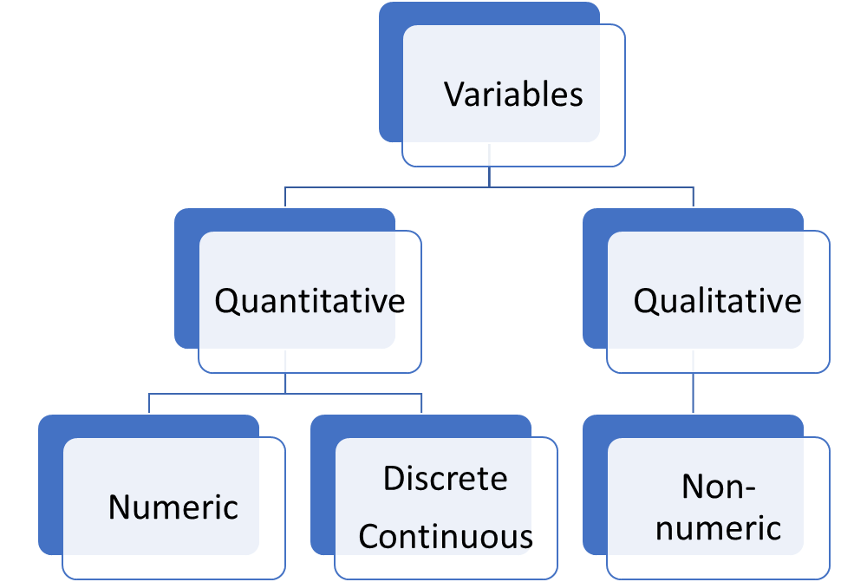
Quantitative and Qualitative

Slide 41
Explanation of Terms
Quantitative Data-Data Values that are Numeric; Ex- math anxiety score
Qualitative Data- Data values that can be placed into distinct categories according to some characteristic; Ex-eye color, hair color, gender, types of foods, drinks; typically either/or
Notes:
What types of variables are: years of education, #of SJSU events you attend each month, weight, favorite shampoo, # of people who voted for Obama, percentage of people who voted for Obama, 31 flavors at Baskin Robbins, # of times Dr. House insults someone,

Slide 42
Learning a new language
Types of variables
How it can be measured matters
  Discrete variables
    What is measured belongs to unique and separate categories
      Pets: dog, cat, goldfish, rats
    If there are only two categories, then it is called a dichotomous variable
      Open or closed; male or female
Chapter 1

Slide 43
Learning a new language
Types of variables
  Continuous variables
    What is measured varies along a line scale and can have small or large units of measure assume values that can take on all values between any two given values;
      Length
      Temperature
      Age
      Distance
      Time
Chapter 1

Slide 44
Levels of Measurement
Numbers are assigned to rank-ordered categories ranging from low to high; Example: Social Class- “upper class” “middle class” Middle class is higher than lower class but we don’t know magnitude of this difference.
Nominal Level
Ordinal Level
Symbols are assigned to a set of categories for purpose of naming, labeling, or classifying observations. Ex- Gender; Other examples include political party, religion, and race; Numbering is arbitrary;

Slide 45
Learning a new language
Measurement scales: Nominal
Measurement scales
  Nominal scales
    Separated into different categories
    All categories are equal
      Cats, dogs, rats
      NOT: 1st, 2nd, 3rd
    There is no magnitude within a category
      One dog is not more dog than another.
Chapter 1

Slide 46
Learning a new language
Measurement scales: Nominal
    No intermittent categories
      No dog/cat or cat/fish categories
    Membership in only one category, not both
Chapter 1

Slide 47
Learning a new language
Measurement scales: Ordinal
  Ordinal scales
    What is measured is placed in groups by a ranking
      1st, 2nd, 3rd
Chapter 1

Slide 48
Learning a new language
Measurement scales: Ordinal
    Although there is a ranking difference between the groups, the actual difference between the group may vary.
      Marathon runners classified by finish order
        The times for each group will be different
        Top ten 4- to 5-hour times
        Bottom ten 4- to 5-week times
Time
1st place
2nd place
3rd place
Chapter 1

Slide 49
Interval-Ratio Level
When categories can be rank ordered, and if measurements for all cases expressed in same units; Examples include age, income, and SAT scores; Not only can we rank order as in ordinal level measurements, but also how much larger or smaller one is compared with another. Variables with a natural zero point are called ratio variables (e.g. income, # of friends) If it is meaningful to say “twice as Much” then it’s a ratio variable.

Slide 50
Learning a new language
Measurement scales: Interval
  Interval scales
    Someone or thing is measured on a scale in which interpretations can be made by knowing the resulting measure.
    The difference between units of measure is consistent.
      Height
      Speed
Length
Chapter 1

Slide 51
Learning a new language
Measurement scales
  Ratio scale
    Just like an interval scale, and there is a definable and reasonable zero point.
      Time, weight, length
    Seldom used in social sciences
    All ratio scales are also interval scales, but not all interval scales are ratio scales
-20
-10
0
+10
+20
Chapter 1

Slide 52
Getting our toes wet
Rounding numbers
  Less than 5, go down
  Greater than 5, go up
  6.60 15.73 51.356
  2.41 9.12 33.842
  22.49 11.06 7.667
  78.55 32.90 43.115
Chapter 1

Slide 53
Getting our toes wet
Σ (sigma)
Useful symbols
Σ (sigma): used to indicate that the group of numbers will be added together
x is 3, 78, 32, 15
Σx = 3 + 78 + 32 + 15
Σx = 128
Chapter 1

Slide 54
Getting our toes wet
Σ (sigma)
Let’s try it
x = 7, 33, 10, 19
Σx =
x = 62, 21, 73, 4
Σx =
Chapter 1
Notes:
#1: Σx = 69
#2: Σx = 160

Slide 55
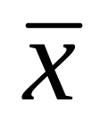
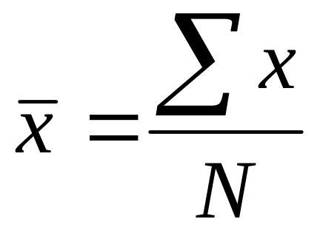
Getting our toes wet
(‘x’ bar)
(‘x’ bar): the mean or average
  Add all the data points together (Σx)
  Divide by the number of data points (N)
Chapter 1

Slide 56

Getting our toes wet
(‘x’ bar)
    Where: x = 3, 12, 6, 5, 11, 15, 1, 7
    Σx = 60
    N = 8
Chapter 1

Slide 57
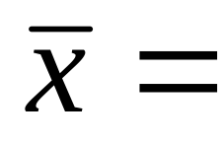
Getting our toes wet
(‘x’ bar)
Let’s try it
x = 3, 7, 1, 4, 4, 2
x = 28, 36, 22, 40, 34, 29
Chapter 1
Notes:
#1: x bar = 3.5
#2: x bar = 31.5

Slide 58
Getting our toes wet
Σx² (Sigma x squared)
Σx² (Sigma x squared)
  Square each number, then
  Add them together
  x = 2, 4, 6, 8
  Σx² = (2)² + (4)² + (6)² + (8)²
  Σx² = 4 + 16 + 36 + 64
  Σx² = 120
Chapter 1

Slide 59
Getting our toes wet
Σx² (Sigma x squared)
Let’s try it
x = 1, 3, 5, 7
Σx² =
x = 4, 3, 9, 1
Σx² =
Chapter 1
Notes:
#1 = 84
#2 = 107

Slide 60
Getting our toes wet
(Σx)² (The square of Sigma x)
(Σx)² (The square of Sigma x)
  Sum all the numbers, then
  Square the sum
x = 5, 7, 2, 3
(Σx)² = (5 + 7 + 2 + 3)²
(Σx)² = (17)²
(Σx)² = 289
Chapter 1

Slide 61
Getting our toes wet
(Σx)² (The square of Sigma x)
Let’s try it
x = 7, 7, 3, 2, 5
(Σx)² =
x = 3, 8, 1, 2
(Σx)² =
Chapter 1
Notes:
#1 = 576
#2 = 196

Slide 62
Getting our toes wet
Σx² versus (Σx)²
Σx² versus (Σx)² : not the same
X = 4, 3, 2, 1
Σx² = (4)² + (3)² + (2)² + (1)²
Σx² = (16) + (9) + (4) + (1)
Σx² = 30
(Σx)² = (4 + 3 + 2 + 1)²
(Σx)² = (10)²
(Σx)2 = 100
Chapter 1

Slide 63
Chapter 1
A Gentle Introduction
Chapter 1

